Slide 1
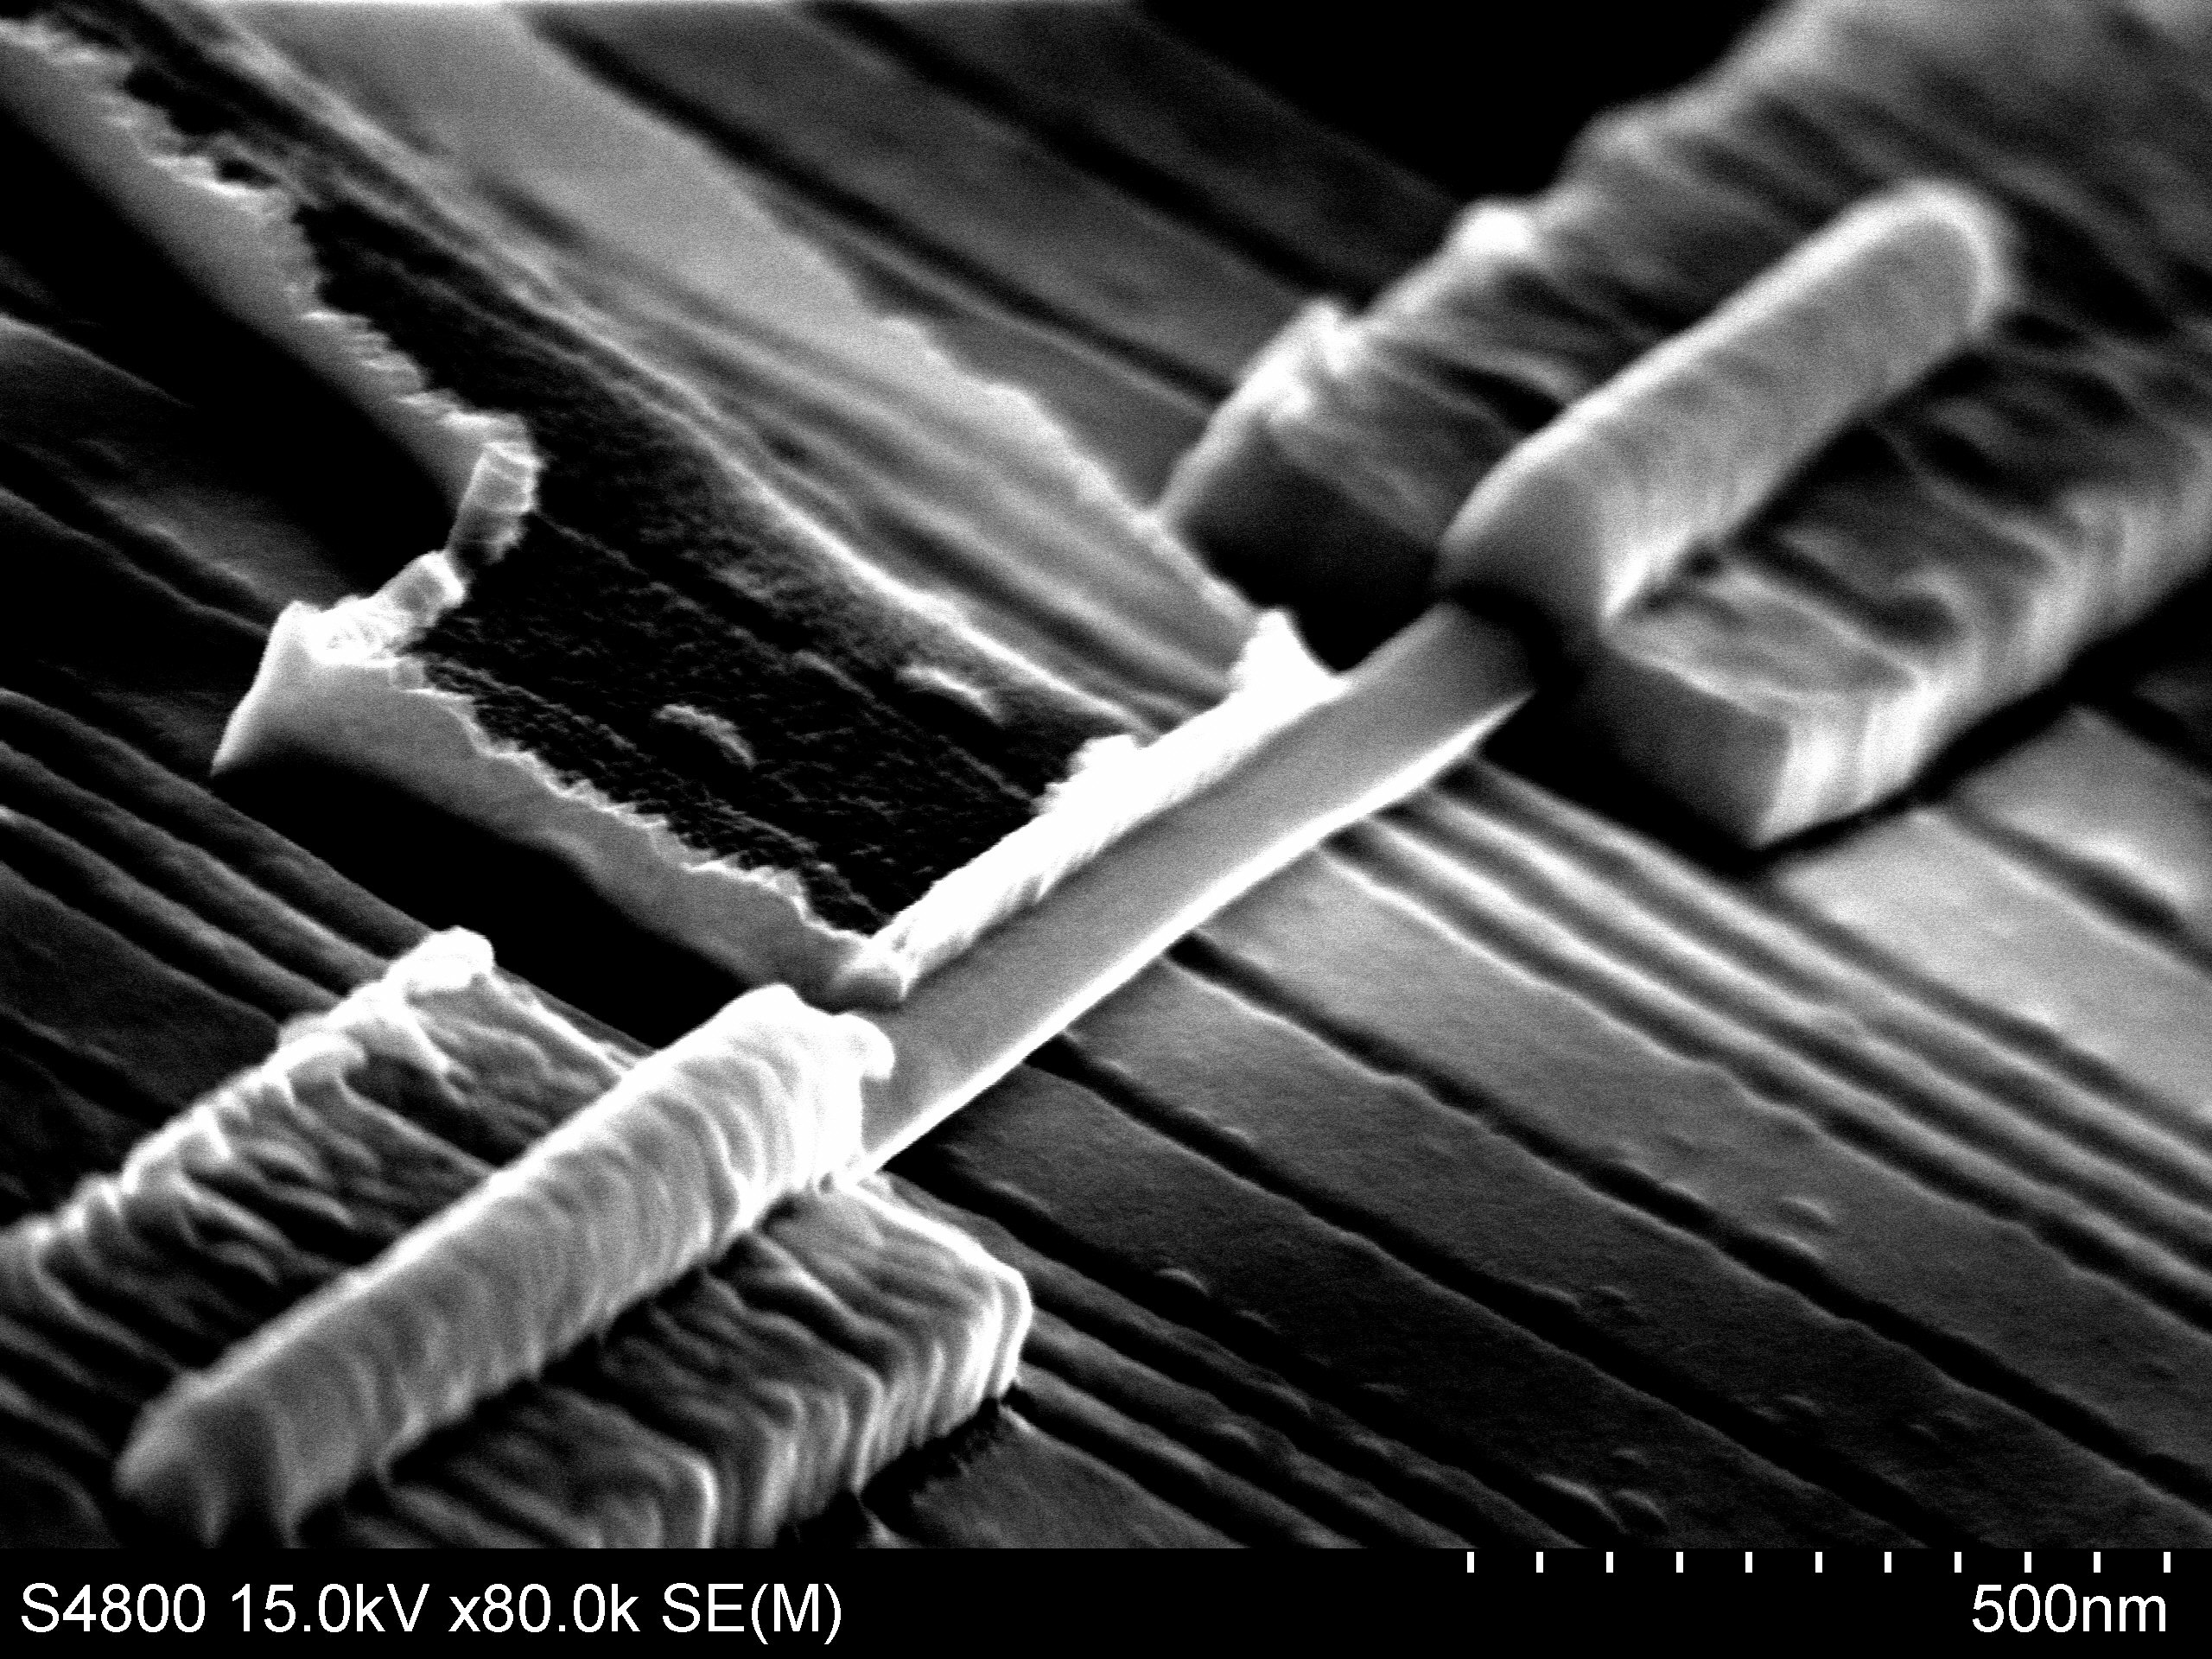
Majorana fermions in
hybrid superconductor-semiconductor nanowire devices
Vincent Mourik & Kun Zuo
David van Woerkom
Sebastien Plissard, Erik Bakkers
Sergey Frolov, Leo Kouwenhoven
Quantum transport group
Delft University of Technology

Slide 2


Majoranas in condensed matter
γ = c + c†
- quasiparticles:
- not fermions: non-Abelian statistics
- show up at the ends of a 1D p-wave superconductor:
1
1
2
2
A. Yu. Kitaev; Unpaired Majorana fermions in Quantum Wires, Physics Uspekhi (2001)

Slide 3
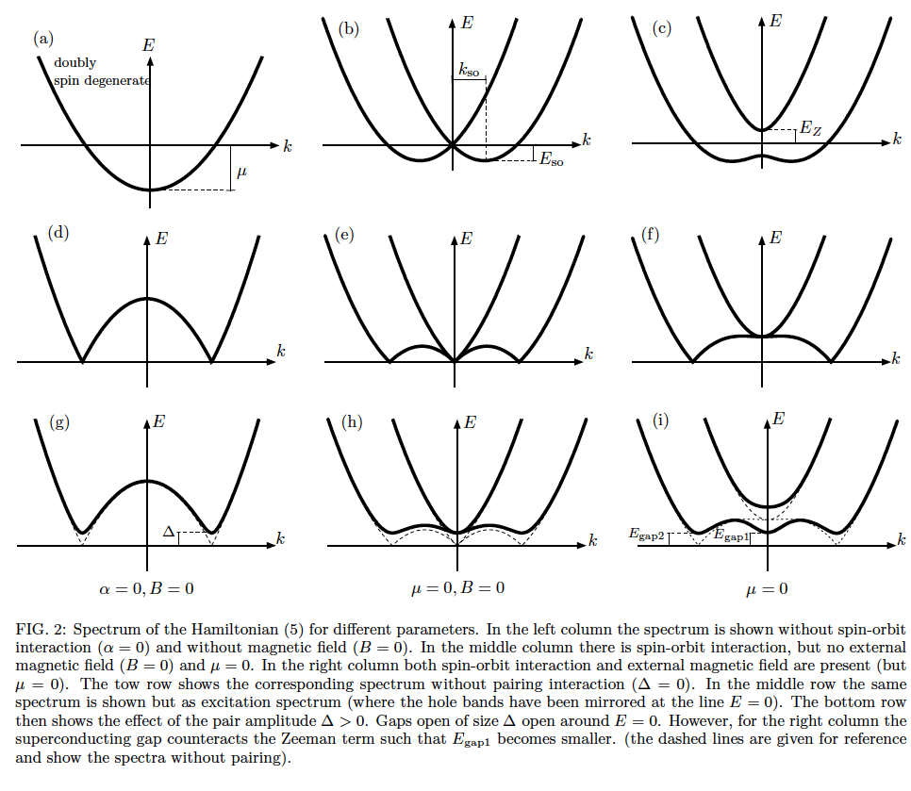
(Lutchyn, Sau, Das Sarma, PRL 2010,
Oreg, Refael, von Oppen, PRL 2010)
Majorana recipe
- One-dimensional quantum wire
- Spin-orbit interaction
External magnetic field (orthogonal to SOI)

Slide 4


Majorana recipe
- Add s-wave superconductivity
+ Δ
Fermi niveau
$$E_{gap1}= \sqrt{Δ^{2}+μ^{2}}−E_{Z}$$
$$E_{gap2}=\frac{2\left|∆\right|E_{SO}}{\sqrt{E_{SO}\left(2E_{SO}+\sqrt{E_{Z}^{2}+4E_{SO}^{2}}\right)}}\sim \frac{\left|∆\right|}{\sqrt{E_{Z}}}$$
(μ = 0)

Slide 5
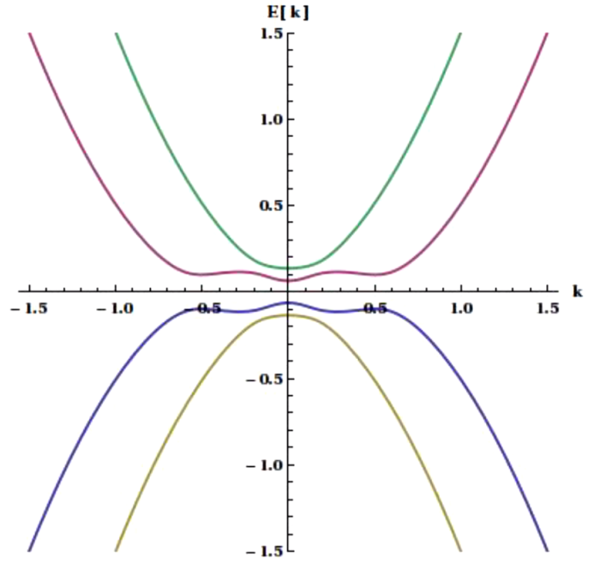
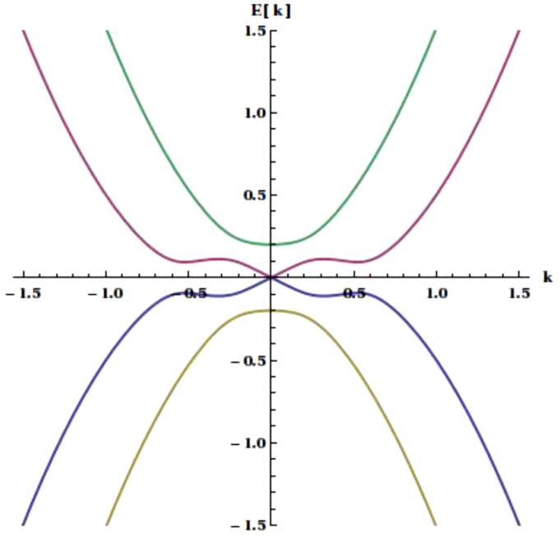

Topological phase transition
$$E_{gap1}= \sqrt{Δ^{2}+μ^{2}}−E_{Z}$$
1
1
2
2
E_{Z} < Δ
E_{Z} = Δ
E_{Z} > Δ
Trivial Superconductor
“positive gap”
Majorana
Gap is closed
Topological Superconductor
“negative gap”

Slide 6
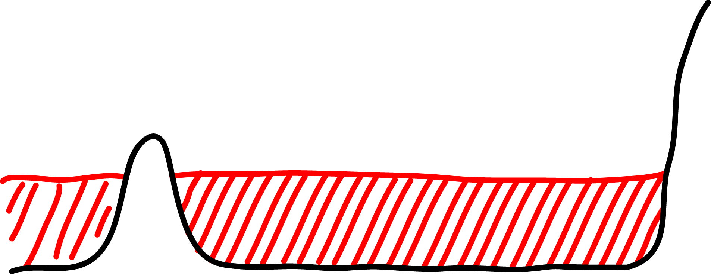
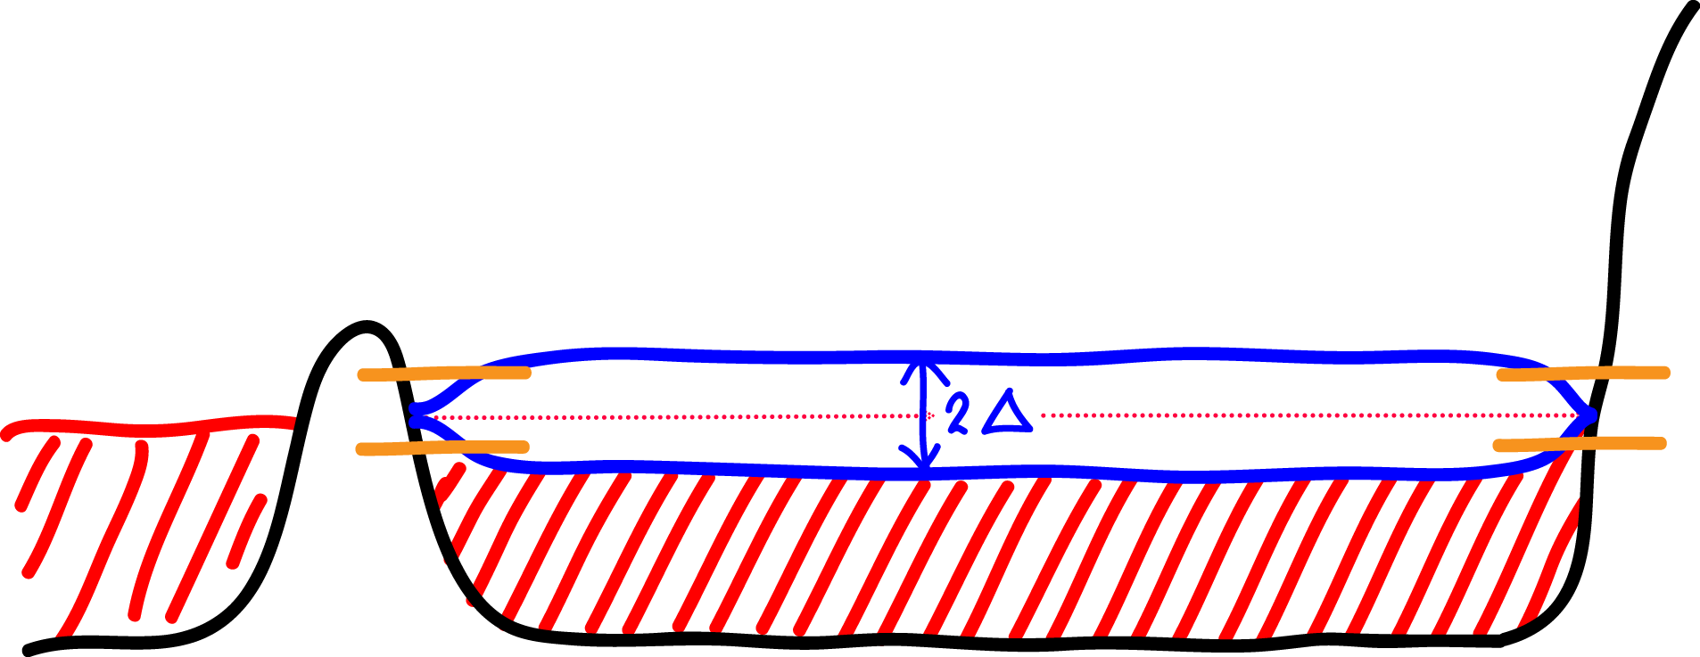
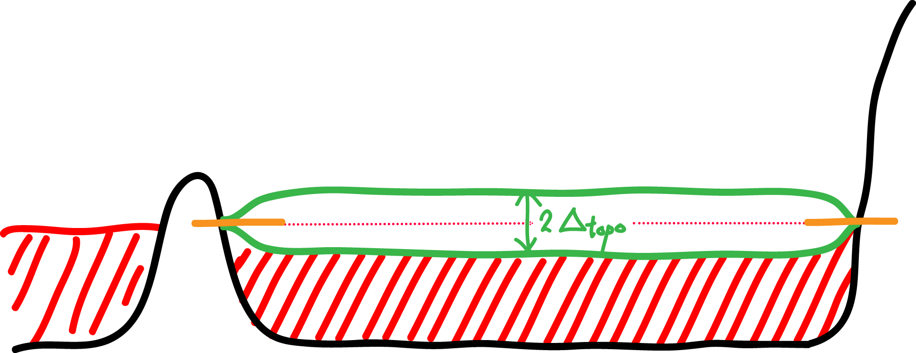
E_{F}
superconductor
superconductor
B
B_{so}

Slide 7
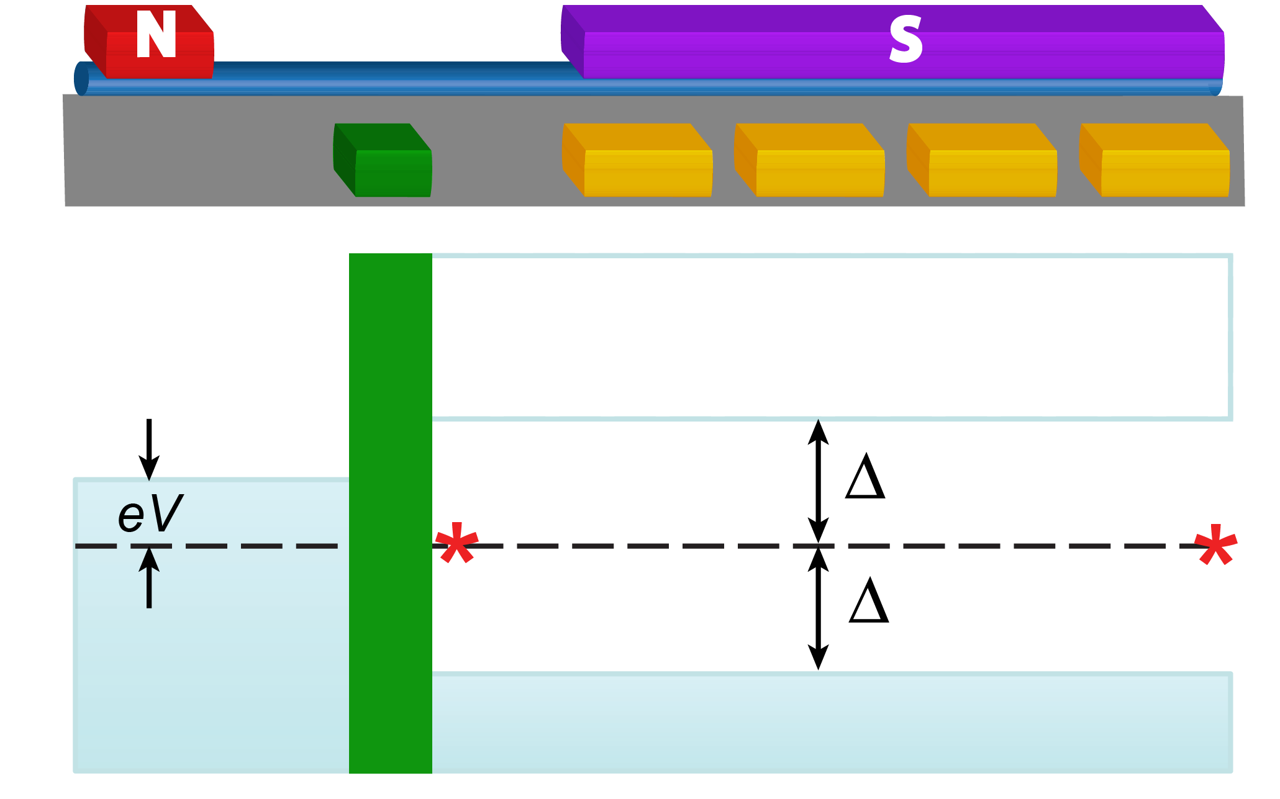
Tunneling experiment
Tunneling into a Majorana bound state:
Resonant Andreev current!
- Zero bias peak, 2e²/h conductance
- Leads to modified QPC plateau
Law, Lee & Ng PRL 2009
A
Wimmer et al. , NJP 2011
1
2
3
4
Notes:
7

Slide 8
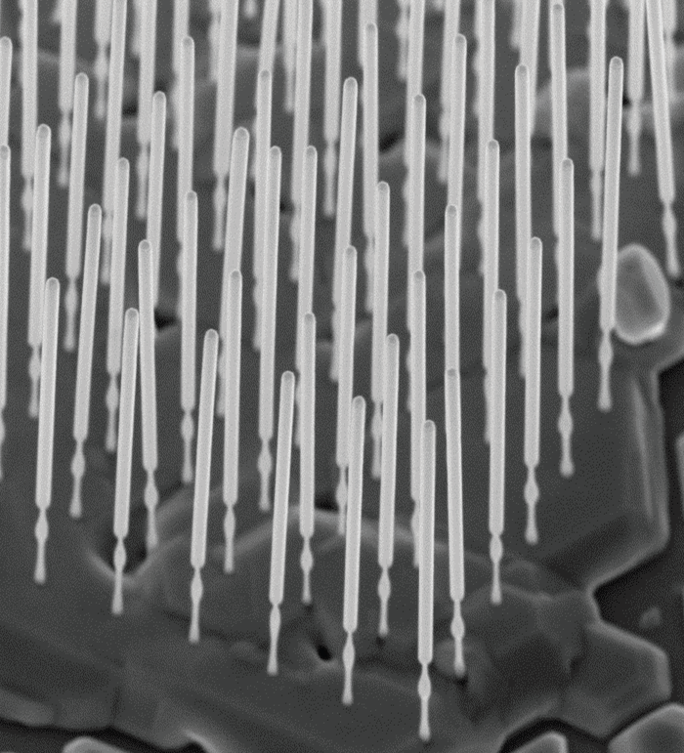
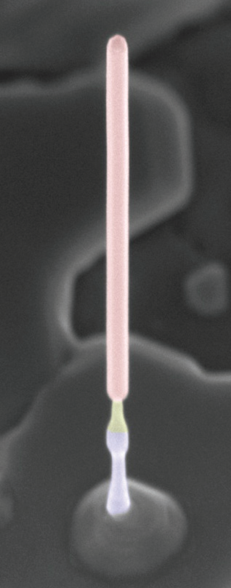
InSb Zinc Blende Nanowires
Why InSb?
High mobility
Large spin-orbit
Large g-factor
Easy ohmic
contact
InSb
InAs
stem
length ~ 2-3 μm
diameter 80-120 nm
Plissard et al., Nano Letters (2012)
Notes:
In collaboration with Erik Bakkers we have developed the growth of InSb nanowires. InSb wires only grow on top of an InAs stem. We can grow reproducibly wires with lengths of several micrometers and constant diameter (~100nm).
8

Slide 9
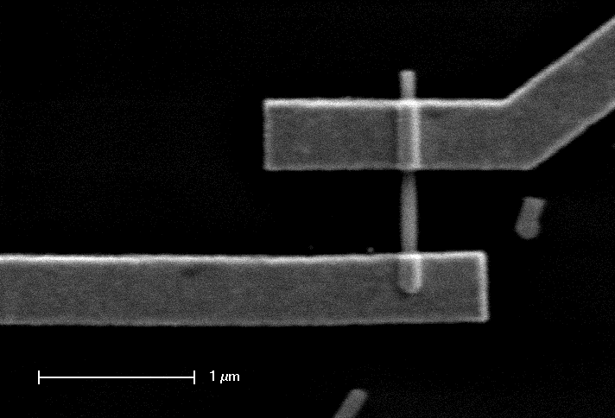
Majorana recipe
One-dimensional quantum wire
Spin-orbit interaction
Superconductivity
Magnetic field
500 nm
2
B = 4T
1.5
1
Conductance (2e²/h)
0.5
0
0
1
2
3
4
5
Gate voltage (V)
van Weperen et al. Nano Letters 2013

Slide 10
Majorana recipe
B = 4T
One-dimensional quantum wire
Spin-orbit interaction
Superconductivity
Magnetic field
Mobility ~ 40,000 cm²/Vs
Mean free path ~ 300 nm
quasi-ballistic transport
van Weperen et al. Nano Letters 2013

Slide 11
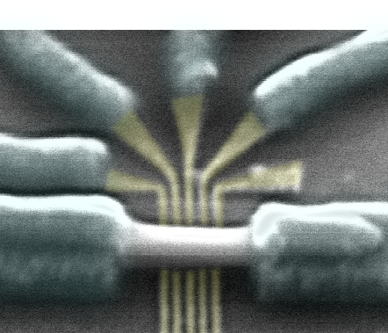
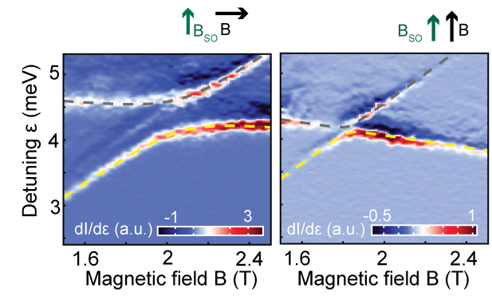
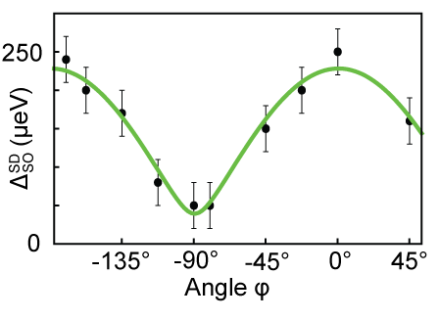
Majorana recipe
One-dimensional quantum wire
Spin-orbit interaction
Superconductivity
Magnetic field
B_{SO}
k
l_{so} = 100-300 nm
triplet
triplet
singlet
singlet
Nadj-Perge et al. PRL 2012

Slide 12
Majorana recipe
One-dimensional quantum wire
Spin-orbit interaction
Superconductivity
Magnetic field
E_{so}
E
B_{SO}
k

Slide 13
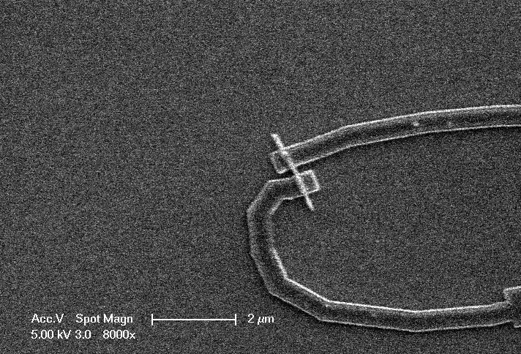
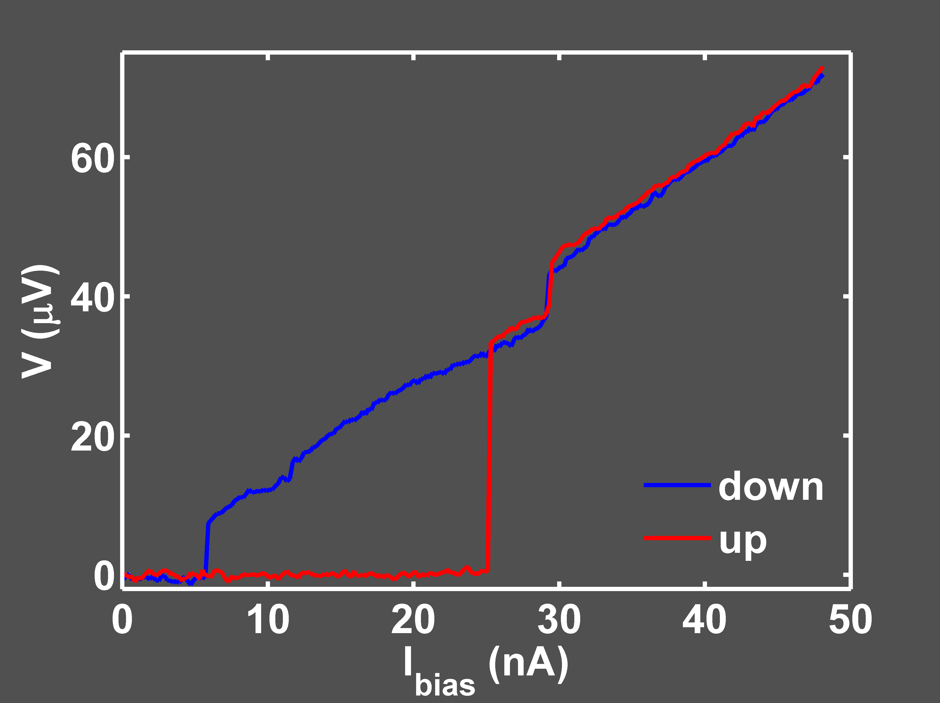
Majorana recipe
InSb wire
Ti/NbTiN contact (10/100 nm)
Global backgate
One-dimensional quantum wire
Spin-orbit interaction
Superconductivity
Magnetic field
Contact spacing
= 250 nm
R_{n} = 1.4 kΩ

Slide 14
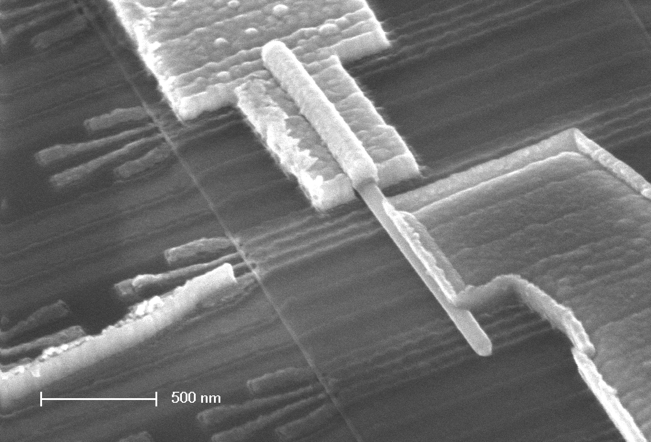
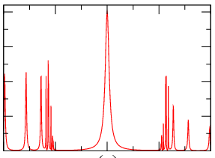
?
?
Ti/Au
?
NbTiN
?
NbTiN
InSb
nanowire
NbTiN
1 micron

Slide 15
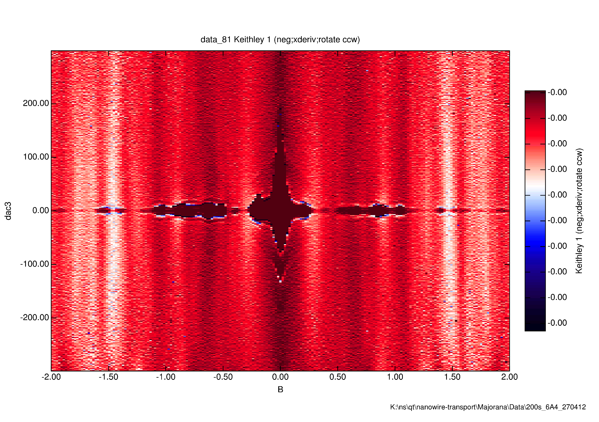
Supercurrents surviving to 2 Tesla.
Contact spacing = 900 nm
(Dark regions near zero bias = supercurrent)
dV/dI (a.u.)
2000
I (pA)
0
-2000
-2.0
B (T)
2.0

Slide 16
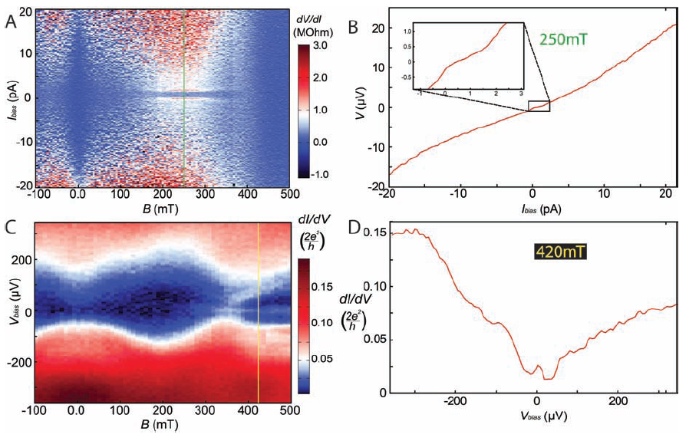
Play with gates – make ZBP due to Josephson appear at finite field!

Slide 17
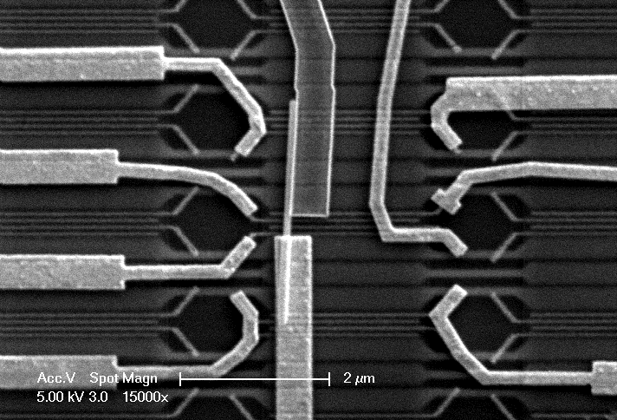
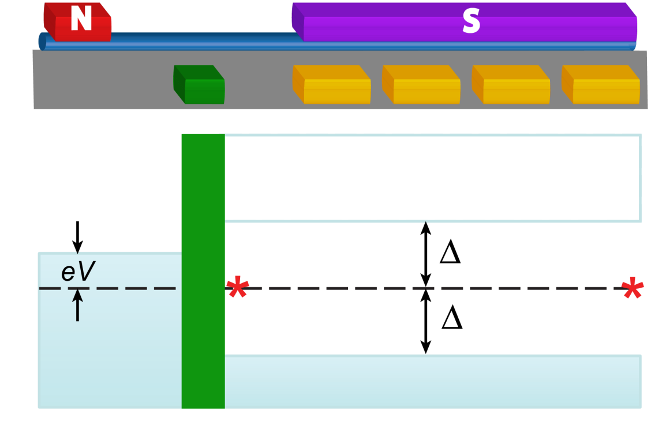
N-NW-S devices
(Au-InSb-NbTiN)
4
S
3
2
1
B = 0
1 μm
N
B
2Δ
0.2
1
2
3
4
dI/dV (2e²/h)
0
-400
0
400
V (μV)

Slide 18
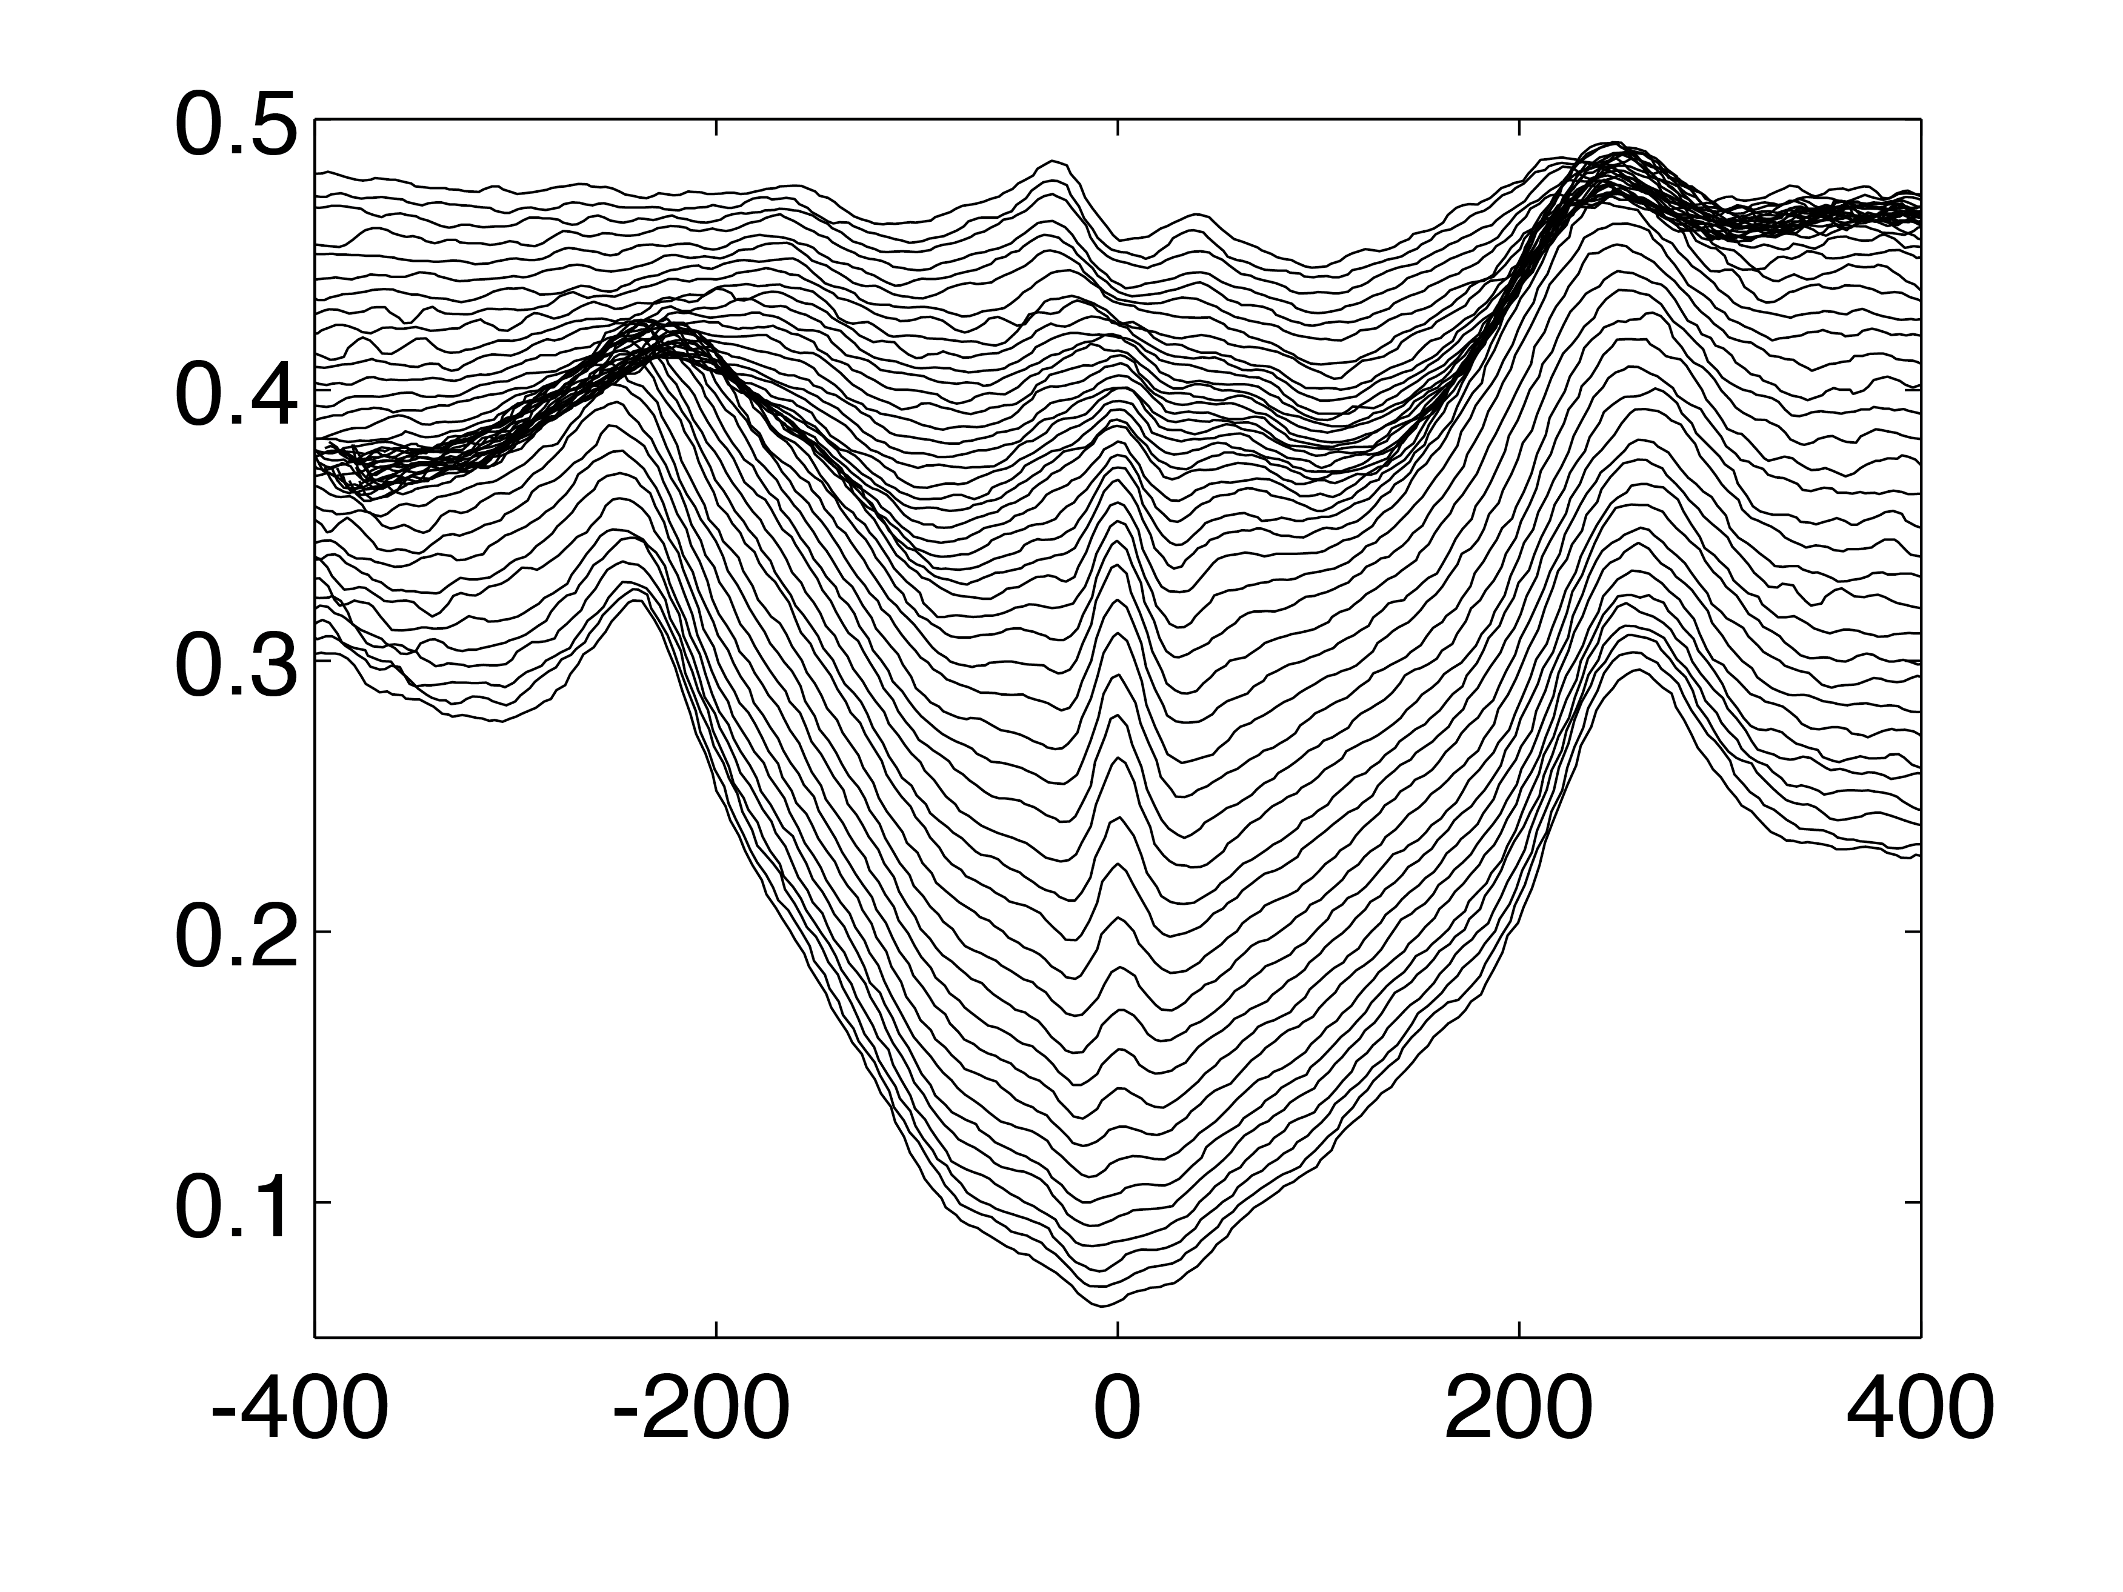
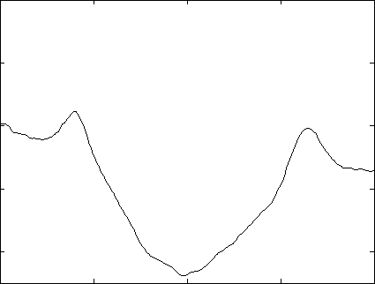
Finite field zero bias peak
0.5 T
dI/dV (2e²/h)
B = 0
V (μV)
More details: V. Mourik, K. Zuo et al., Science Vol. 336 no. 6084 pp. 1003-1007

Slide 19
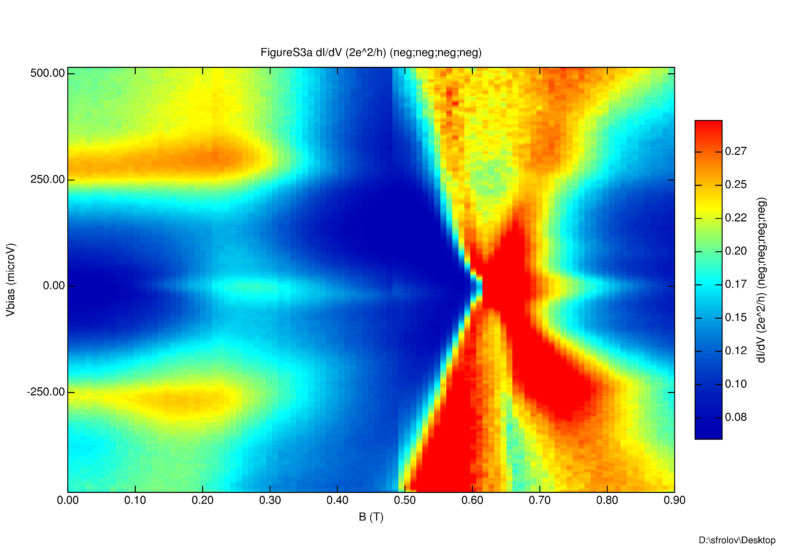
Peak onset E_{Z} ~ Δ
+Δ
250
1 Tesla = 1.5 meV
0
V (μV)
-250
-Δ
0
0.1
0.5
0.9
Magnetic Field (T)

Slide 20
How would Kondo effect look?
g = 50
g = 2
V (μV)

Slide 21

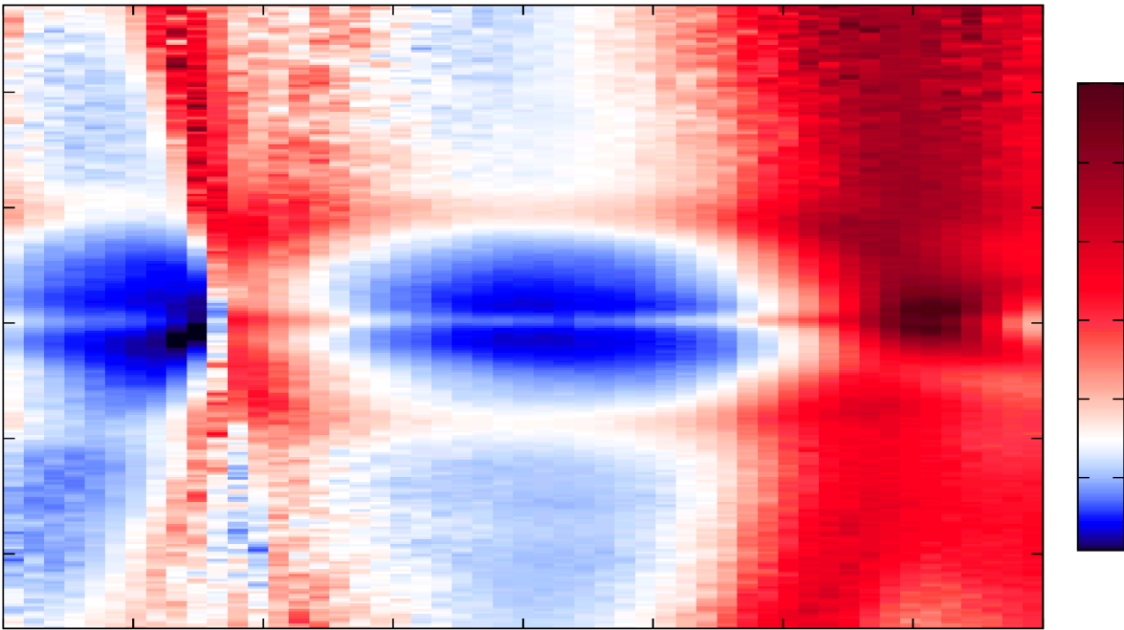
Gate dependence: under S contact
*
1
2
3
4
A
175 mT
(2e²/h)
500
0.7
V (μV)
0
0.2
-500
-10
0
10
Voltage on Gate 2 (V)

Slide 22
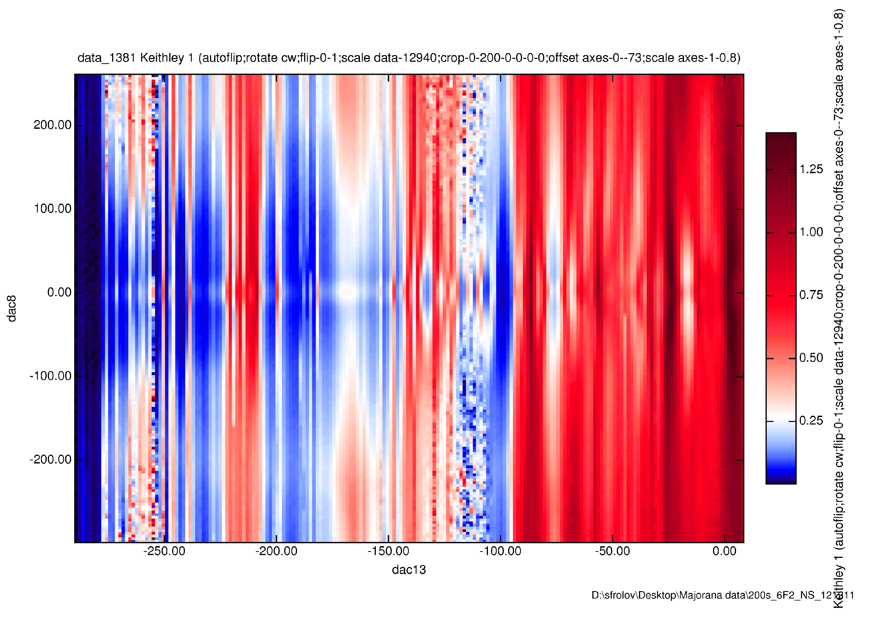
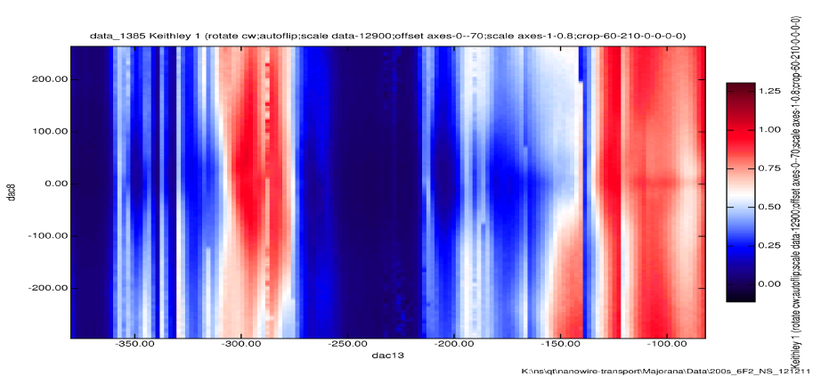
Gate dependence: barrier gate
*
1
2
3
4
200
1.25
dI/dV
(2e²/h)
0
V (μV)
-200
0.25
-1.25
Barrier gate (V)
0.0
200
1.25
0
dI/dV
(2e²/h)
V (μV)
-200
0.0
-1.75
Barrier gate (V)
-0.5

Slide 23
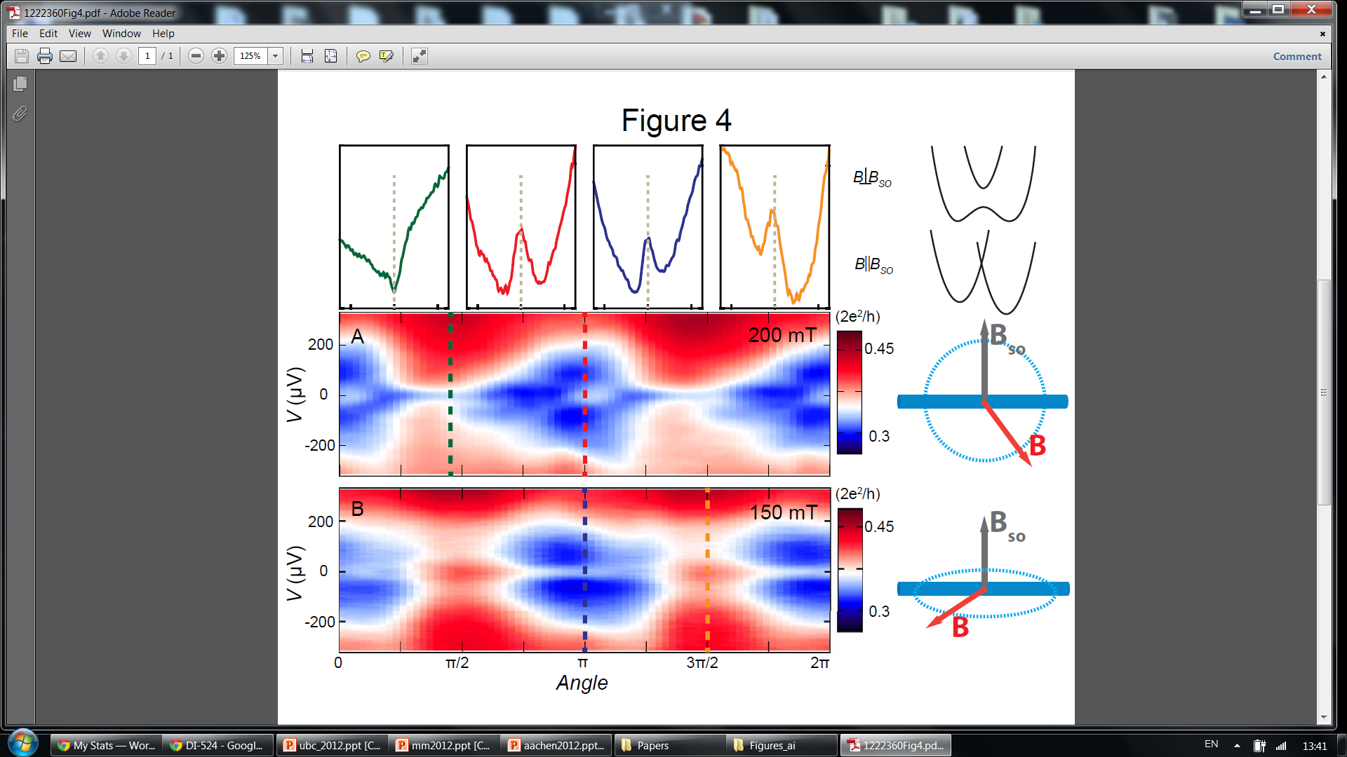
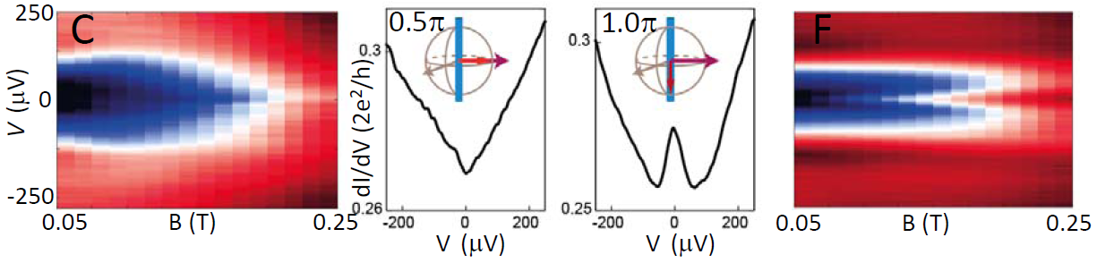
Majorana recipe
One-dimensional quantum wire
Spin-orbit interaction
Superconductivity
Magnetic field
✔
✔
See Supplementary Info for scans along all 4π directions in 3D space

Slide 24
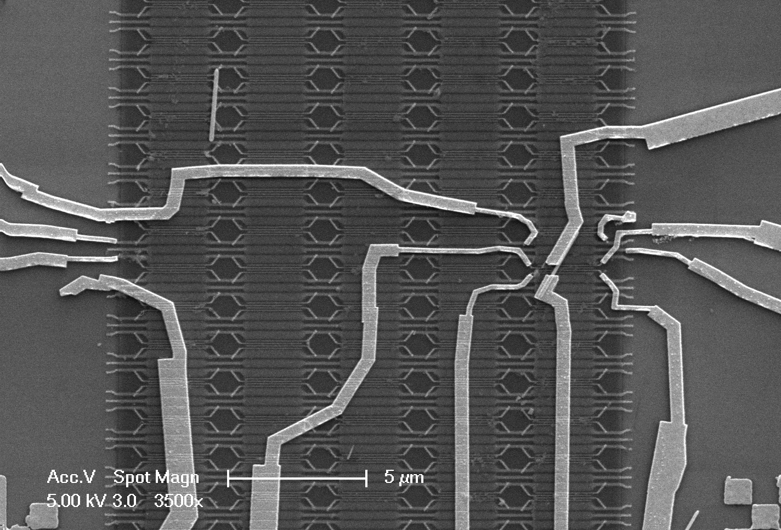
Majorana recipe
One-dimensional quantum wire
Spin-orbit interaction
Superconductivity
Magnetic field
✔
✔
No robust zero bias peaks observed
✔
Au
B
3
2
1
Au
2.5 μm

Slide 25
Our signatures of Majoranas
Zero bias peak (ZBP) onsets at B ~ 100 mT
E_{z} ~ 150 μeV, so E_{z} ~ Δ
ZBP remains stuck to zero bias over significant range of B
(peak width 30 μeV, ΔE_{z} ~ 0.5-1.5 meV)
ZBP persist over large gate ranges for all gates, but gate tuning is required!
ZBP vanishes when B is aligned with B_{SO}
ZBP robust in both gate and magnetic field NOT OBSERVED in several N-NW-N devices
Persistent ZBP reproduced in four N-NW-S devices and three cryostats

Slide 26
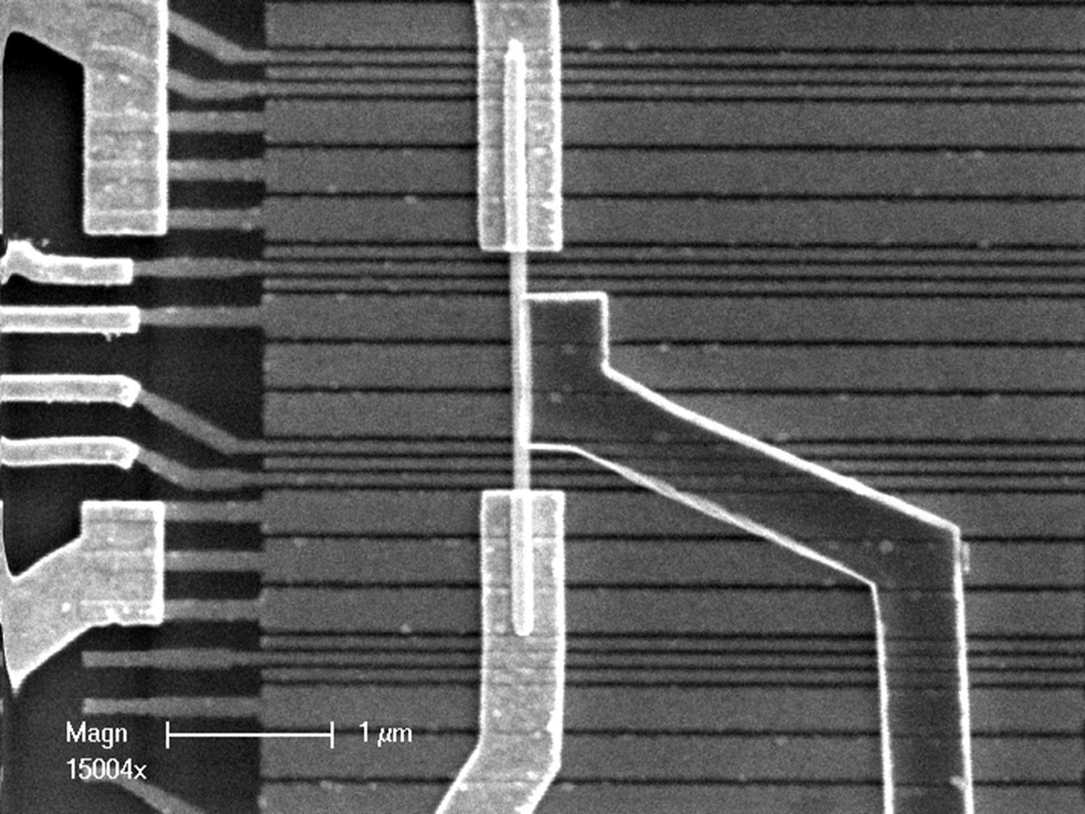
New experiments
N1
gates to define barrier/QPC/QD
3 gates to tune
subbands
S
N2
1 μm

Slide 27
New experiments
Interesting questions:
Are there really 2 Majorana’s?
Is a Majorana large or small compared to the device size?
Do the Majorana’s interact?
Can they be moved by gates?
……

Slide 28
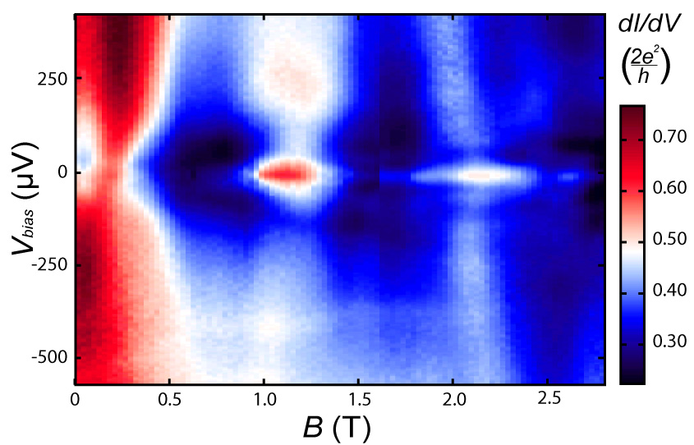
Zero bias peak at finite field

Slide 29
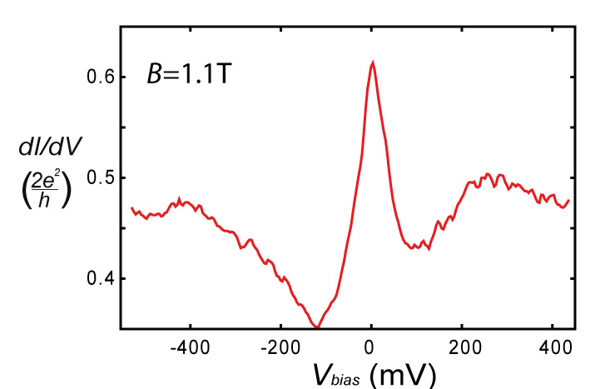
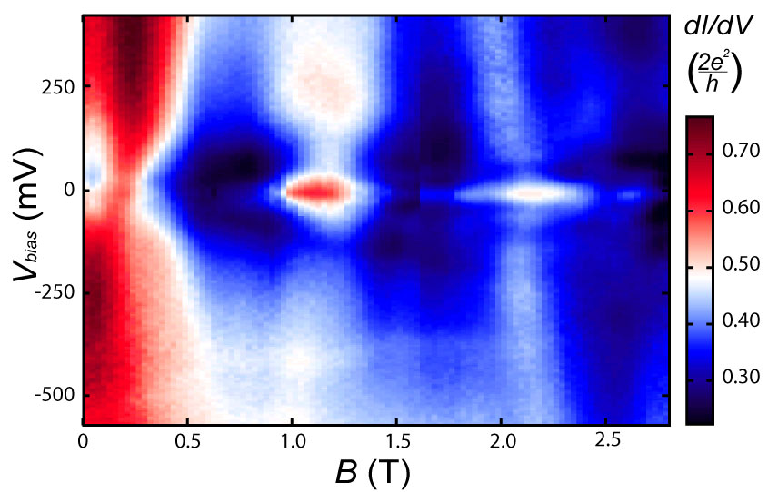
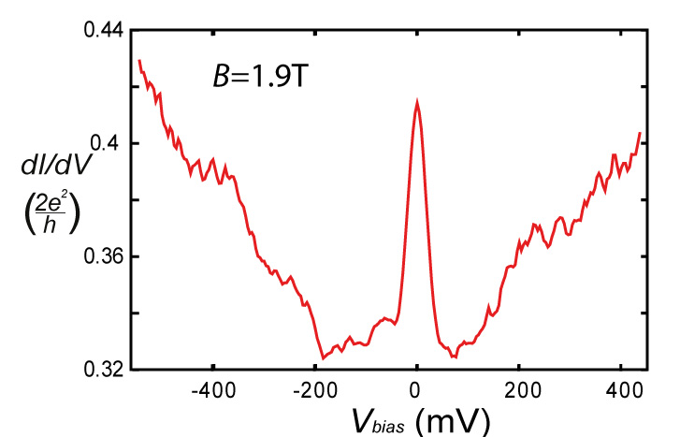
Green
Purple
peak height
~5-10% x 2e²/h
Feature is reproducible

Slide 30
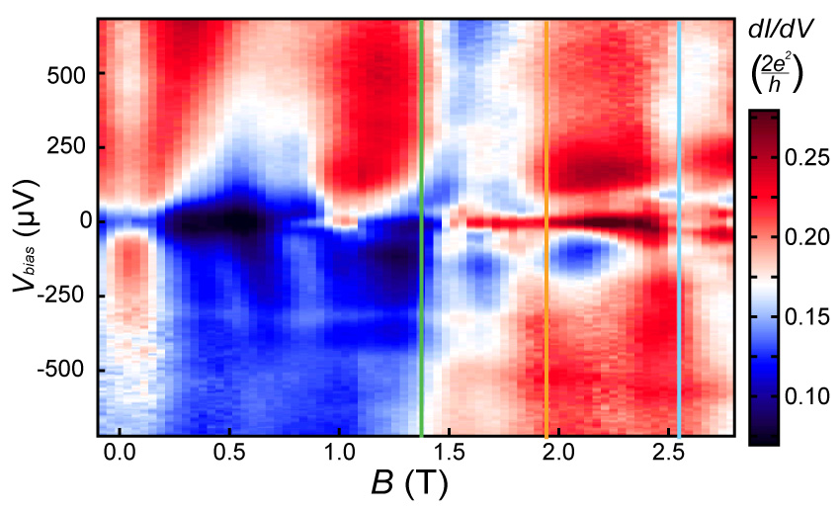
Peak splitting oscillations

Slide 31
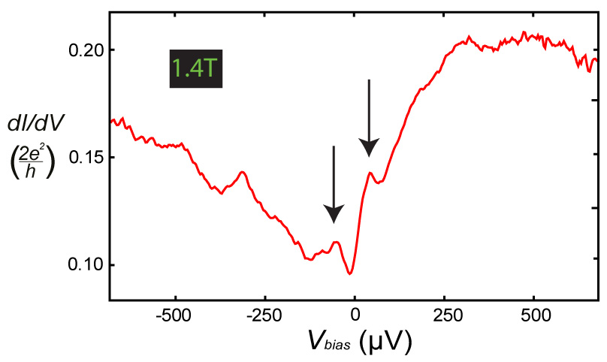
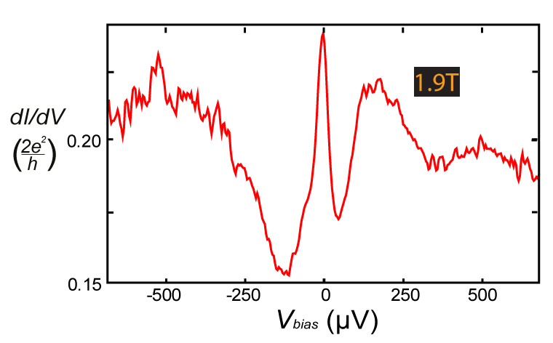
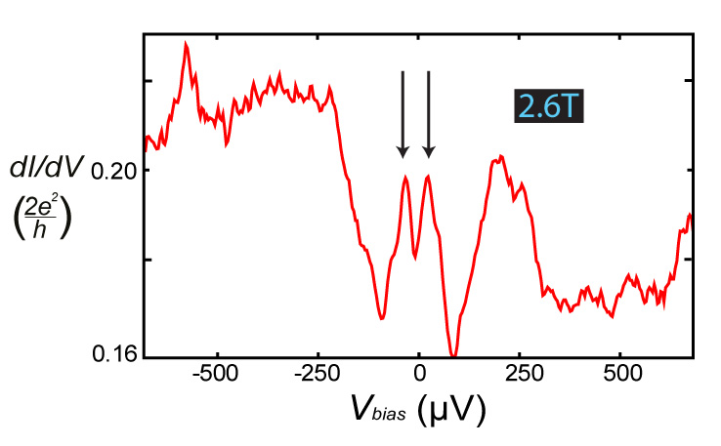

Slide 32
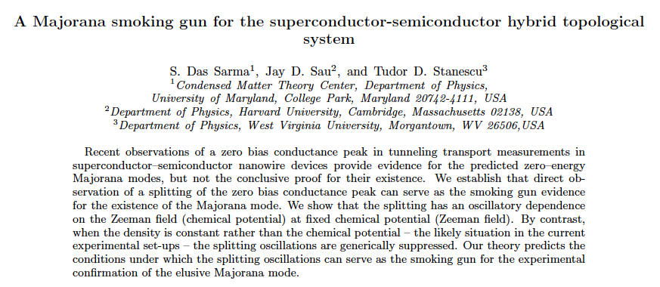

Prada et al. PRB 2012
Das Sarma et al. PRB 2012

Slide 33
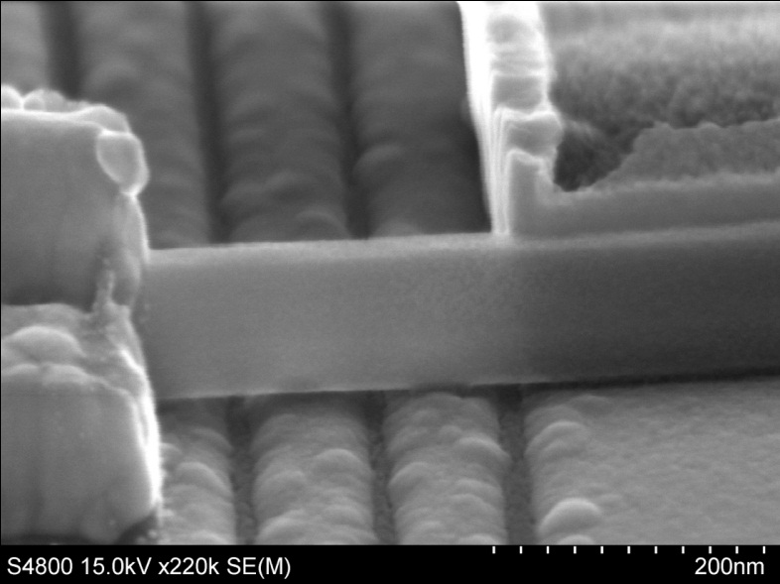
What’s the difference?
Gates at the edge slightly different tuned

Slide 34
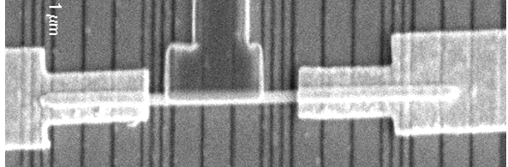
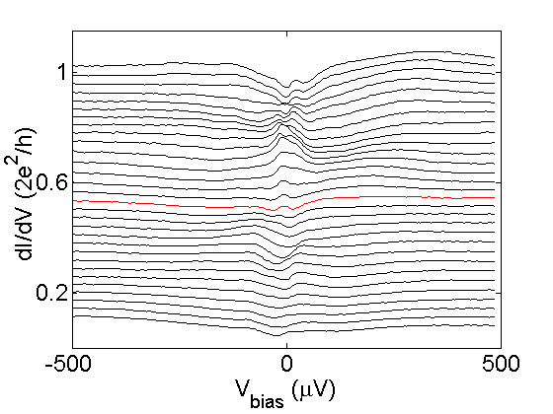
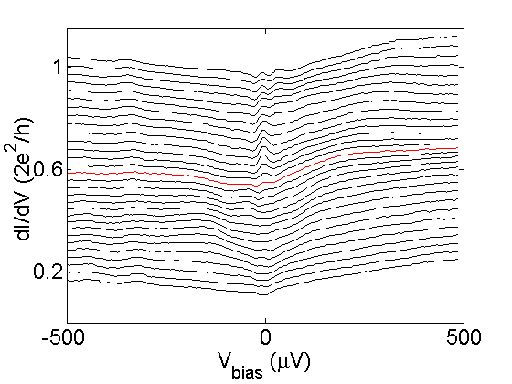
S
N1
N2
N1-S
1T
N2-S
~450 mT
0T
correlation in peak onset

Slide 35
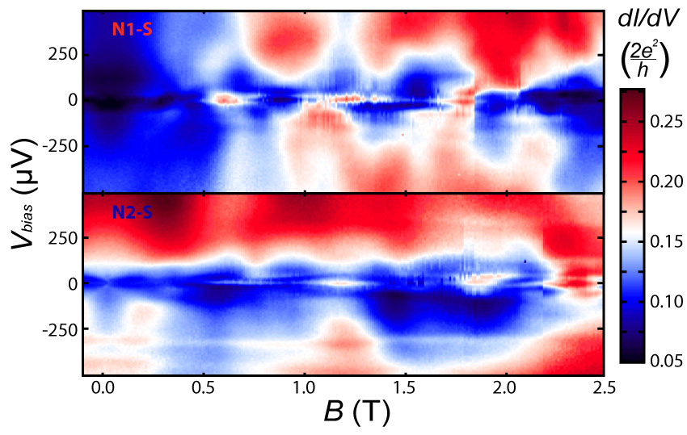
S
N2
N1
splitting
no splitting
➔ not the same single MF pair

Slide 36
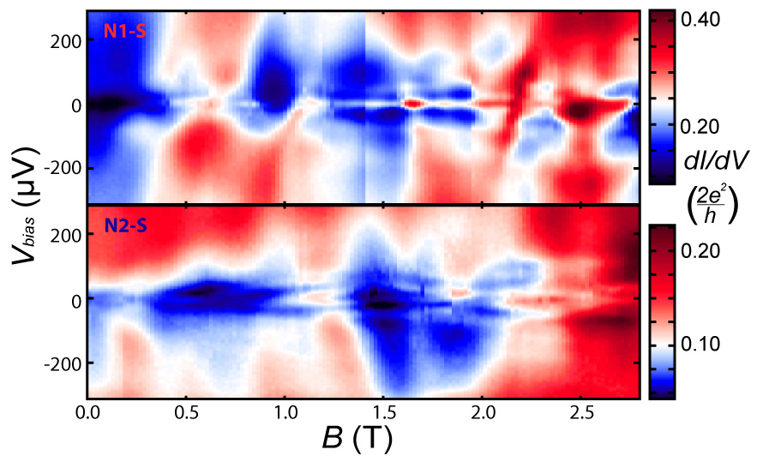
different
gate setting
S
N2
N1
no splitting
splitting
➔ not the same single MF pair

Slide 37
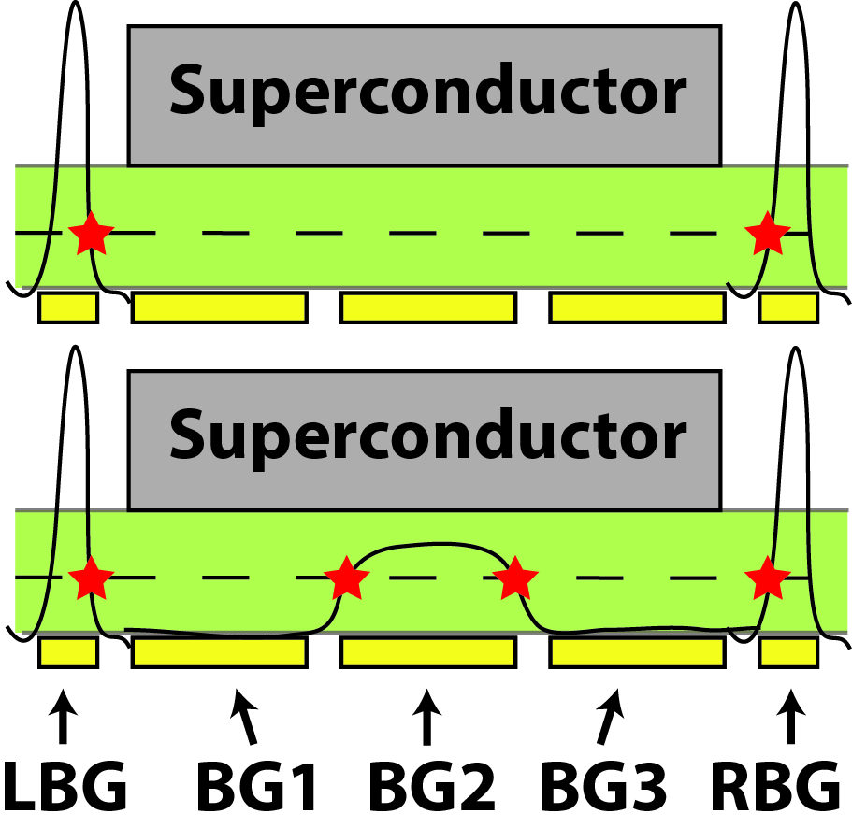
Middle gate tunes peak splitting

Slide 38
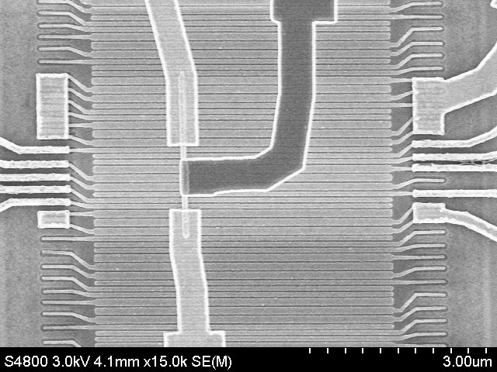
Change of design
N1
600nm S
N2
Half the length of the Superconducting contact
Larger overlap between two Majorana’s (stronger oscillation)
Less disorder in shorter wires (more correlation)

Slide 39
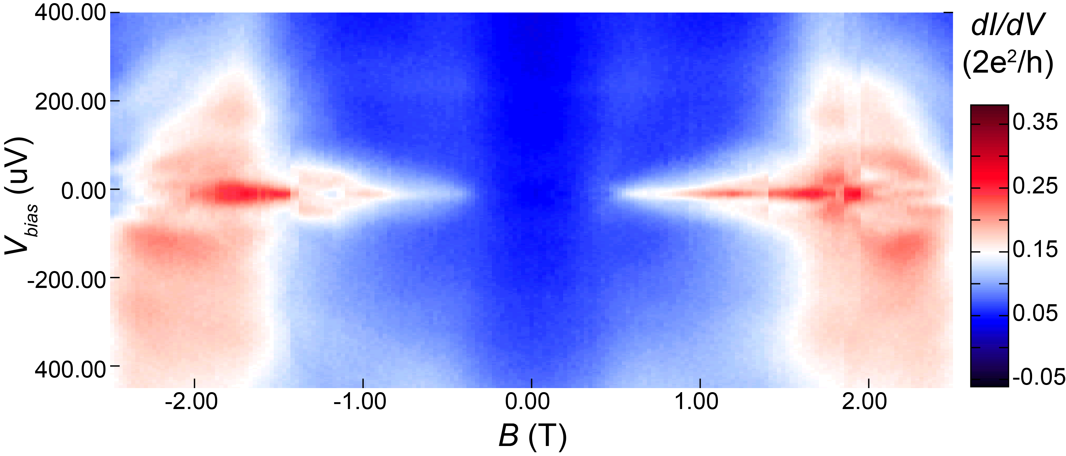
B-field dependence
- By now ZBP’s in > 10 devices.

Slide 40
Much cleaner DOS in the new sample!

Slide 41
BG2
S
N1
N2
Notes:
BG2 = -4.5 V for single peak and BG2 = 5V for split peaks. There is might be a jump here, but in any case the peak shape is very different for these two gate values.

Slide 42
Observations summarized
Single side measurements (true at both sides):
Zero bias feature has been reproduced
In B, gate space: peak - splitted peak oscillations
First gate under S contact is crucial to observe this
Both sides measurements:
Peak patterns globally similar at both sides
There is no correlation at detailed level
Middle gate under S contact is capable of tuning peak (splitting)

Slide 43


Outlook: Braiding
Alicea et al. Nature Physics 2011
Hyart et al. PRB 2013

Slide 44




Observations summarized
Single side measurements (true at both sides):
Zero bias feature has been reproduced
In B, gate space: peak - splitted peak oscillations
First gate under S contact is crucial to observe this
Both sides measurements:
Peak patterns globally similar at both sides
There is no correlation at detailed level
Middle gate under S contact is capable of tuning peak (splitting)

